Slide 1
Data-Link Layer
The Internet is a combination of networks glued together by connecting devices (routers or switches)
If a packet is to travel from a host to another host, it needs to pass through these networks
Data Link layer controls node-to-node communication

Slide 2
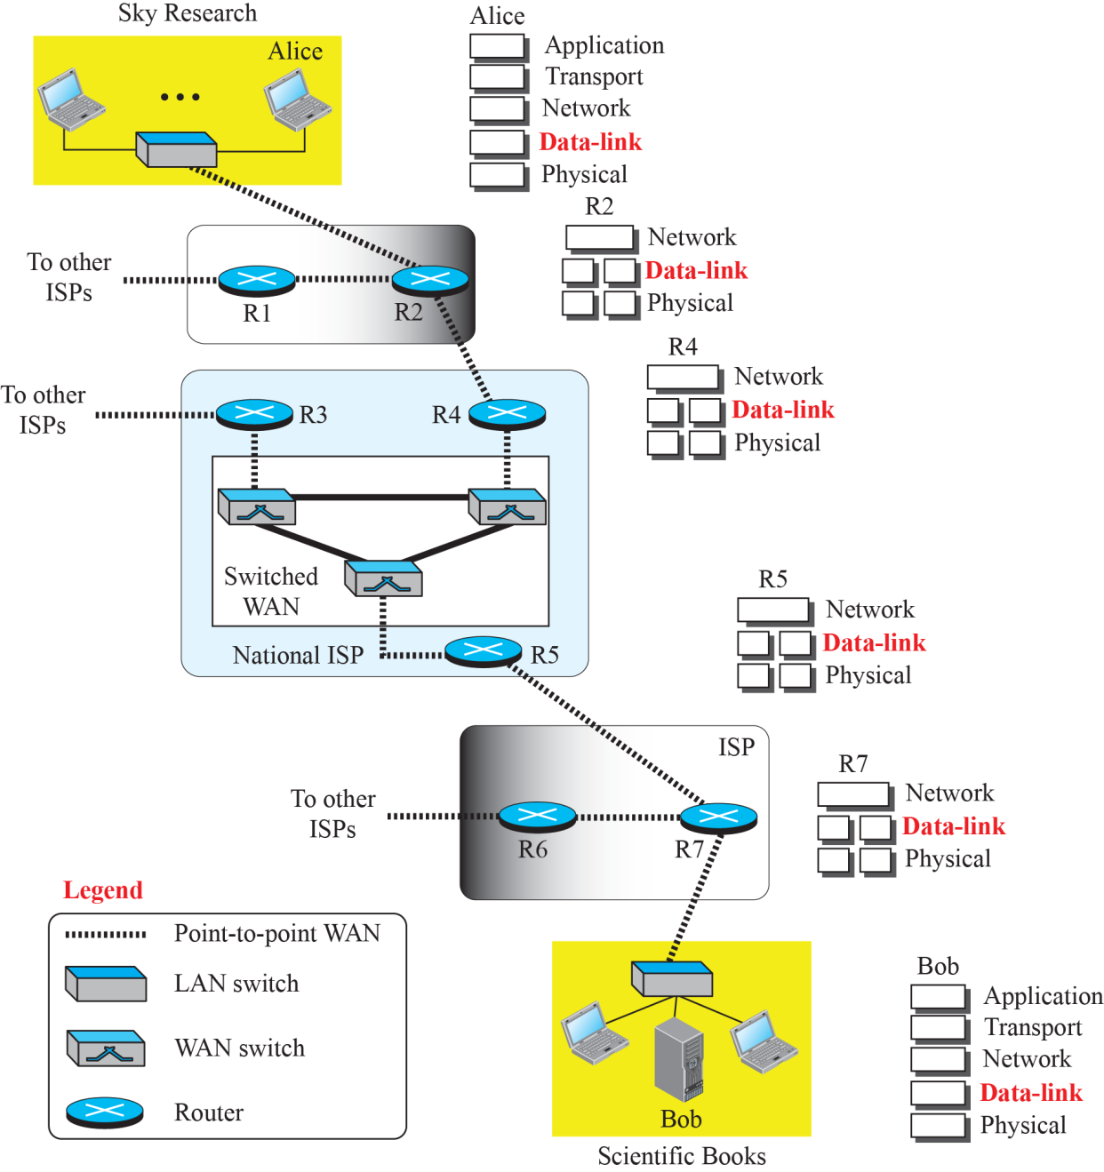
Communication at the Data-Link Layer

Slide 3
Nodes and Links
Communication at the data-link layer is node-to-node
A data unit from one point in the Internet needs to pass through many networks (LANs and WANs) to reach another point
We refer to the two end hosts and the routers as nodes and the networks in between as links

Slide 4
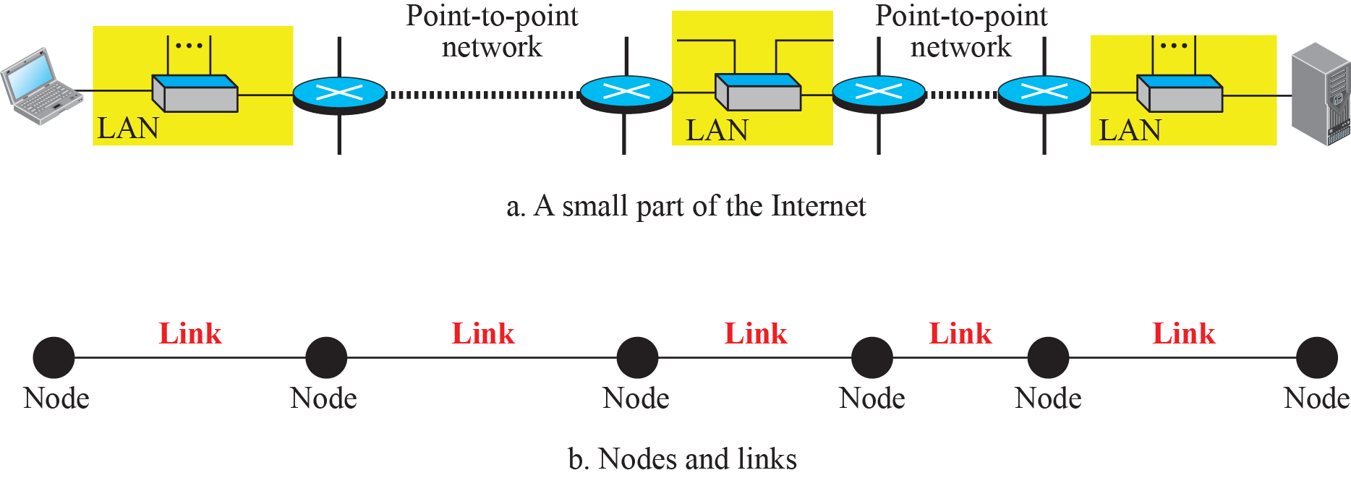
Nodes and Links

Slide 5
Services provided by Data-Link Layer
Located between the physical and the network layers
Provides services to Network Layer and receives services from Physical layer
Framing
Flow Control
Error Control
Congestion Control

Slide 6
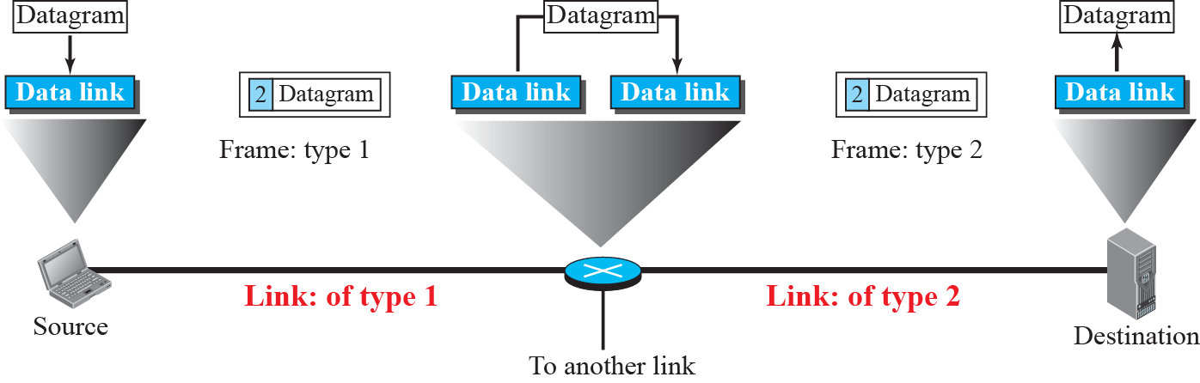
A Communication with only Three Nodes

Slide 7
Services provided by Data-Link Layer
Data-Link layer provides services to Network Layer and receives services from Physical layer
Framing
Flow Control
Error Control
Congestion Control

Slide 8
Two Categories of Links
Two nodes are physically connected by a transmission medium such as cable or air
Data-link layer controls how the medium is used
Data-link layer can use whole capacity
Data-link layer can use only part of the capacity

Slide 9
Two Categories of Links
We can have the following two types of links:
Point-to-point link or a
Broadcast link

Slide 10
Two Sublayers of Data-Link Layer
We can divide the data-link layer into two sublayers:
Data Link Control (DLC)
Media Access Control (MAC)

Slide 11
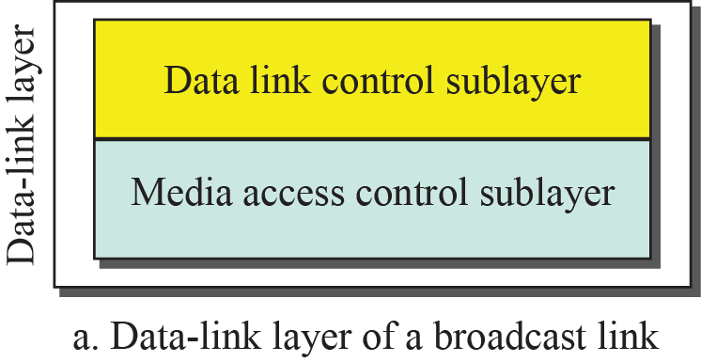
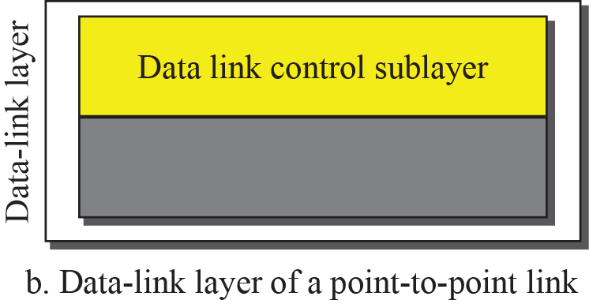
Dividing the data-link layer into two sublayers

Slide 12
Why LINK-LAYER ADDRESSING?
IP addresses are the identifiers at the network layer
In Internet we cannot make a packet reach its destination using only IP addresses
Source and destination IP addresses define the two ends but cannot define which links the packet will take

Slide 13
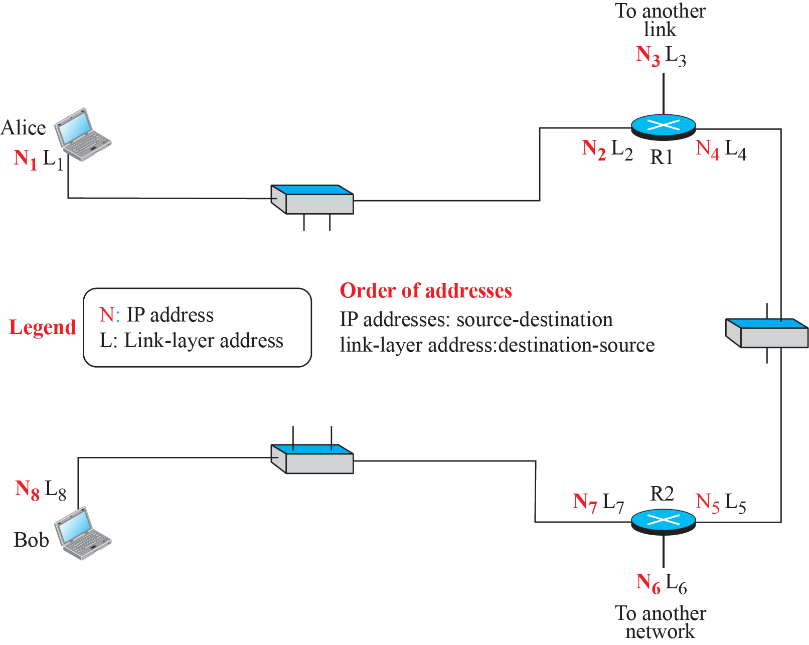
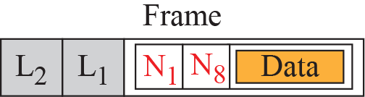
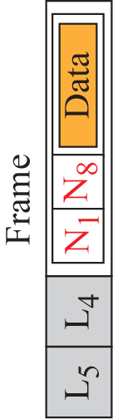
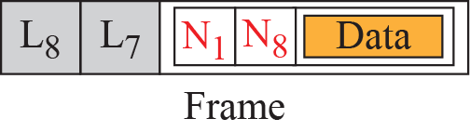
IP addresses & Link-Layer Addresses

Slide 14
Three Types of addresses
Some link-layer protocols define three types of addresses:
Unicast
Multicast
Broadcast

Slide 15
Example
The unicast link-layer addresses in the most common LAN, Ethernet, are 48 bits (six bytes) that are presented as 12 hexadecimal digits separated by colons; for example, the following is a link-layer address of a computer. The second digit needs to be an odd number.
A3:34:45:11:92:F1

Slide 16
Example
The multicast link-layer addresses in the most common LAN, Ethernet, are 48 bits (six bytes) that are presented as 12 hexadecimal digits separated by colons. The second digit, however, needs to be an even number in hexadecimal. The following shows a
multicast address:
A2:34:45:11:92:F1

Slide 17
Example
The broadcast link-layer addresses in the most common LAN, Ethernet, are 48 bits, all 1s, that are presented as 12 hexadecimal digits separated by colons. The following shows a broadcast address:
FF:FF:FF:FF:FF:FF

Slide 18
Address Resolution Protocol (ARP)
Anytime a node has an IP packet to send to another node in a link, it has the IP address of the receiving node
IP address of the next node is not helpful in moving a frame through a link; we need the link-layer address of the next node

Slide 19
Address Resolution Protocol (ARP)
We need Address Resolution Protocol (ARP)

Slide 20
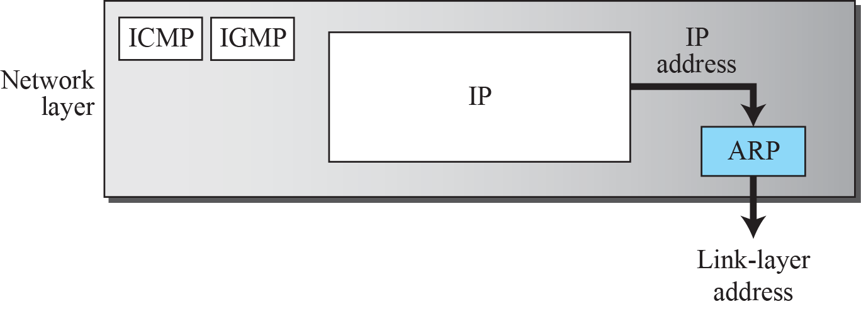
Position of ARP in TCP/IP protocol suite

Slide 21
Address Resolution Protocol (ARP)
Anytime a node has an IP packet to send to another node in a link, it has the IP address of the receiving node
IP address of the next node is not helpful in moving a frame through a link; we need the link-layer address of the next node

Slide 22
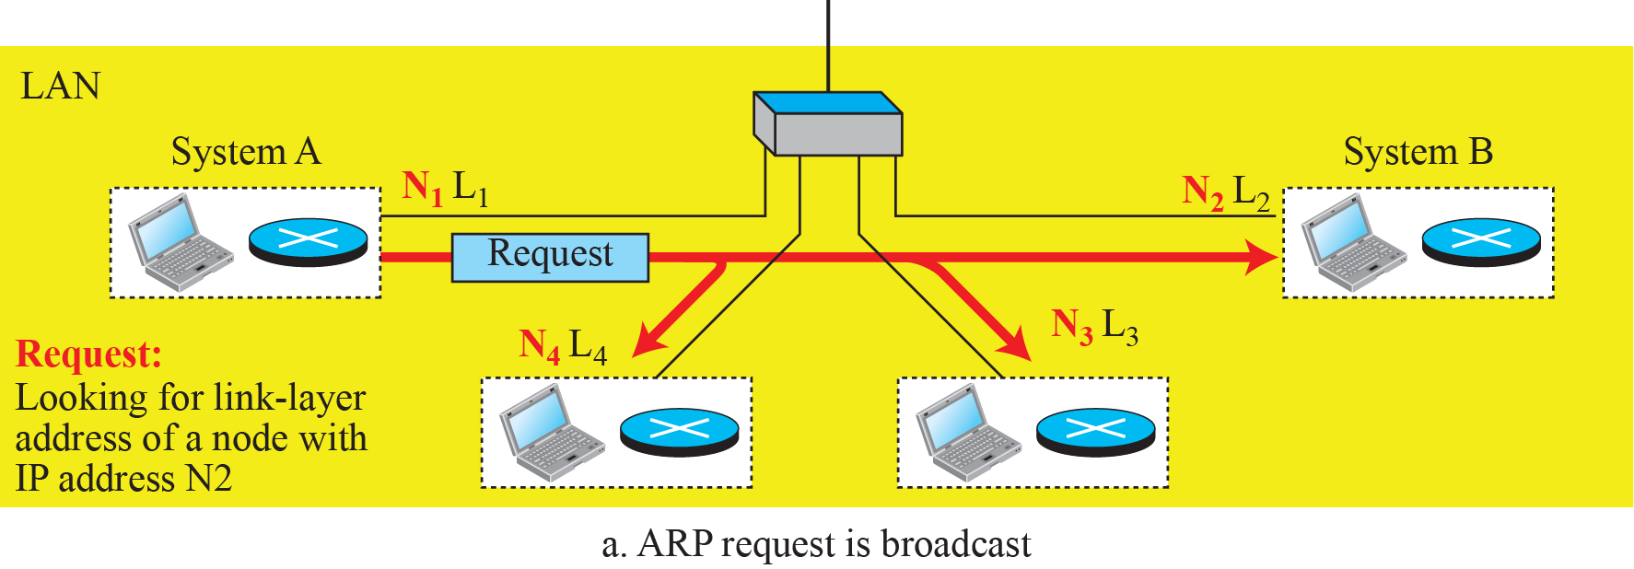
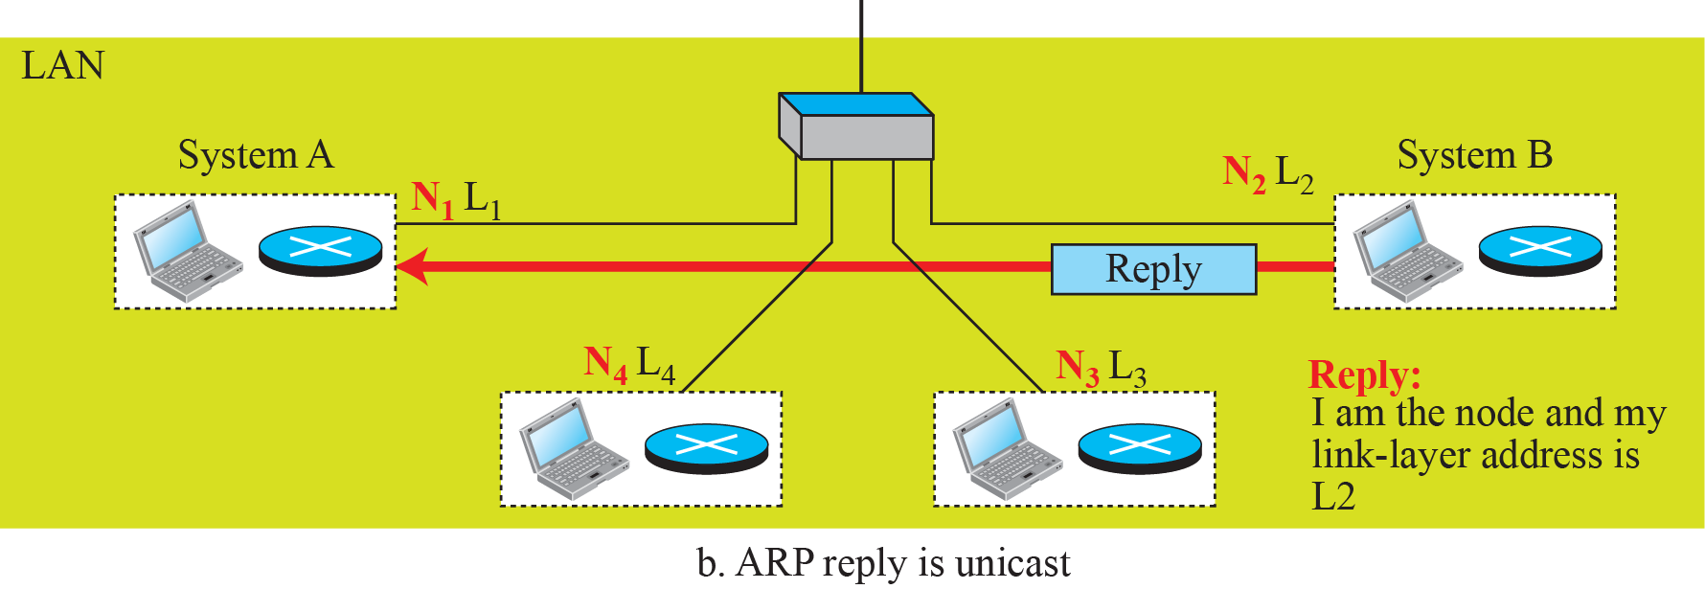
ARP Operation

Slide 23
Address Resolution Protocol (ARP)
Anytime a node has an IP packet to send to another node in a link, it has the IP address of the receiving node
IP address of the next node is not helpful in moving a frame through a link; we need the link-layer address of the next node

Slide 24
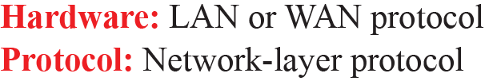
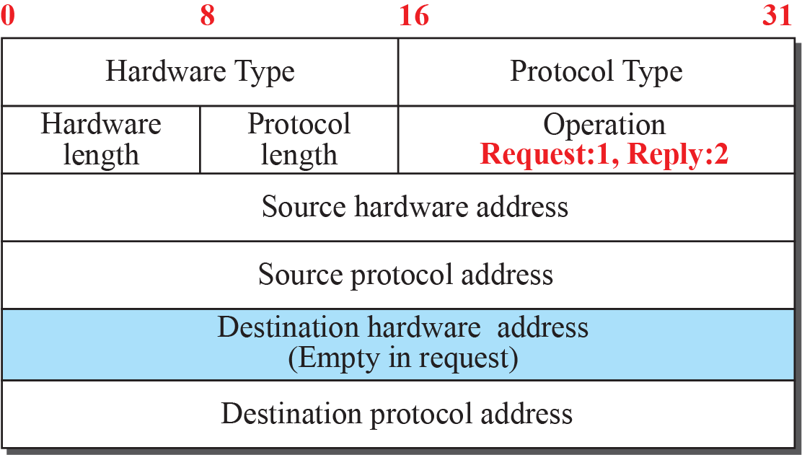
ARP Packet

Slide 25
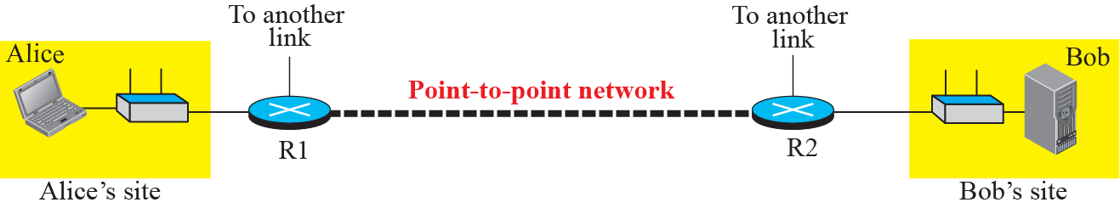
The internet for our example

Slide 26
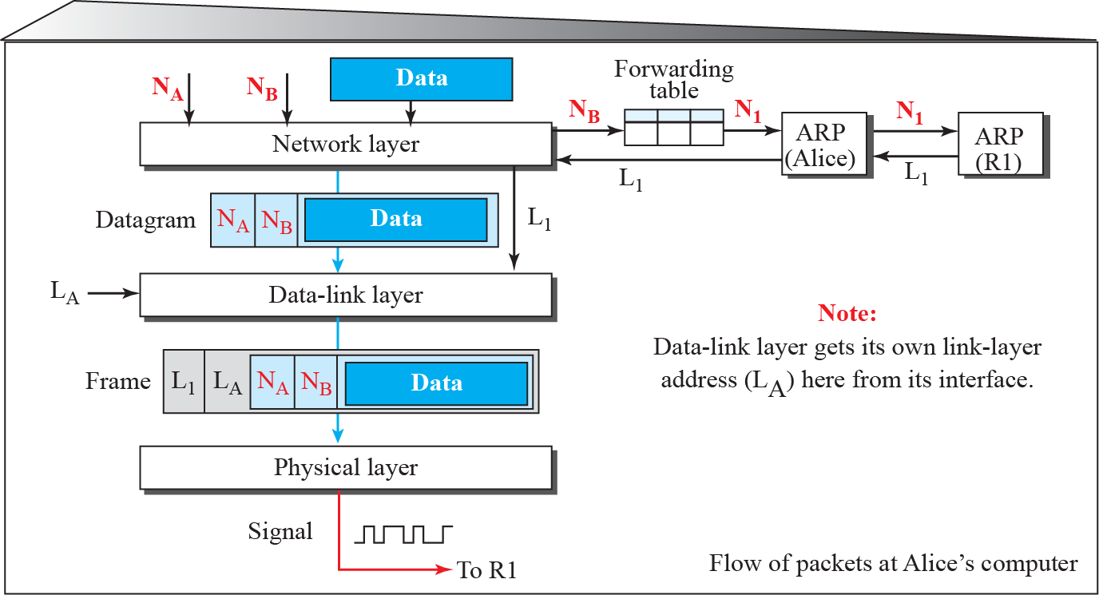
Flow of packets at Alice site

Slide 27
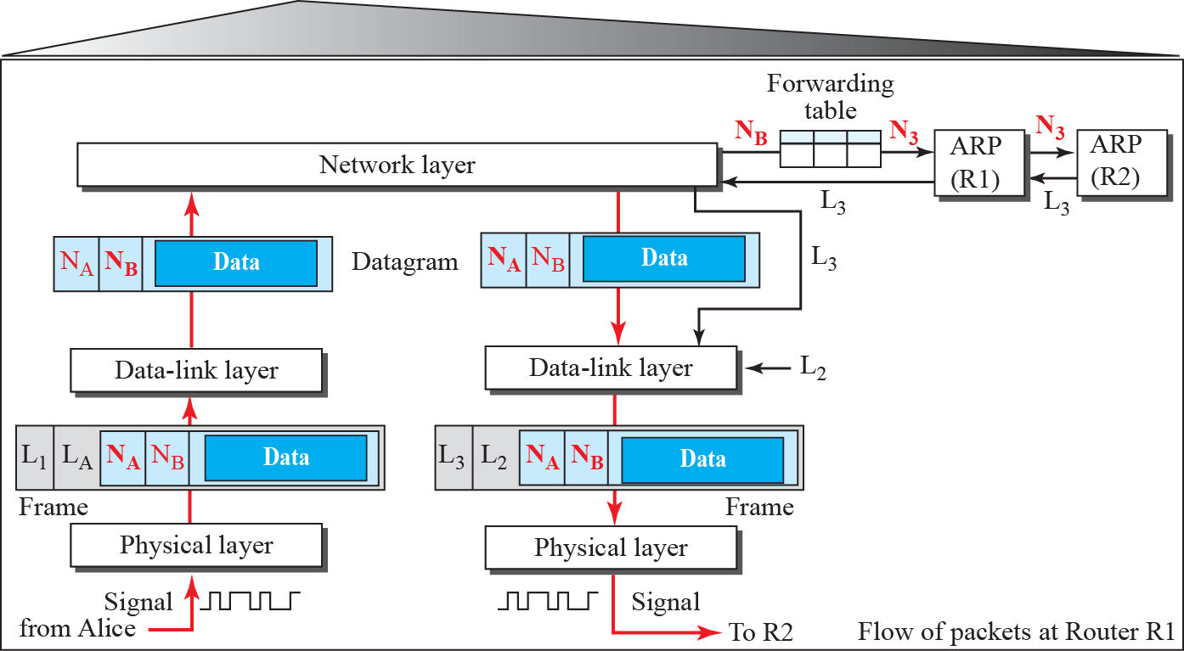
Flow of activities at router R1

Slide 28
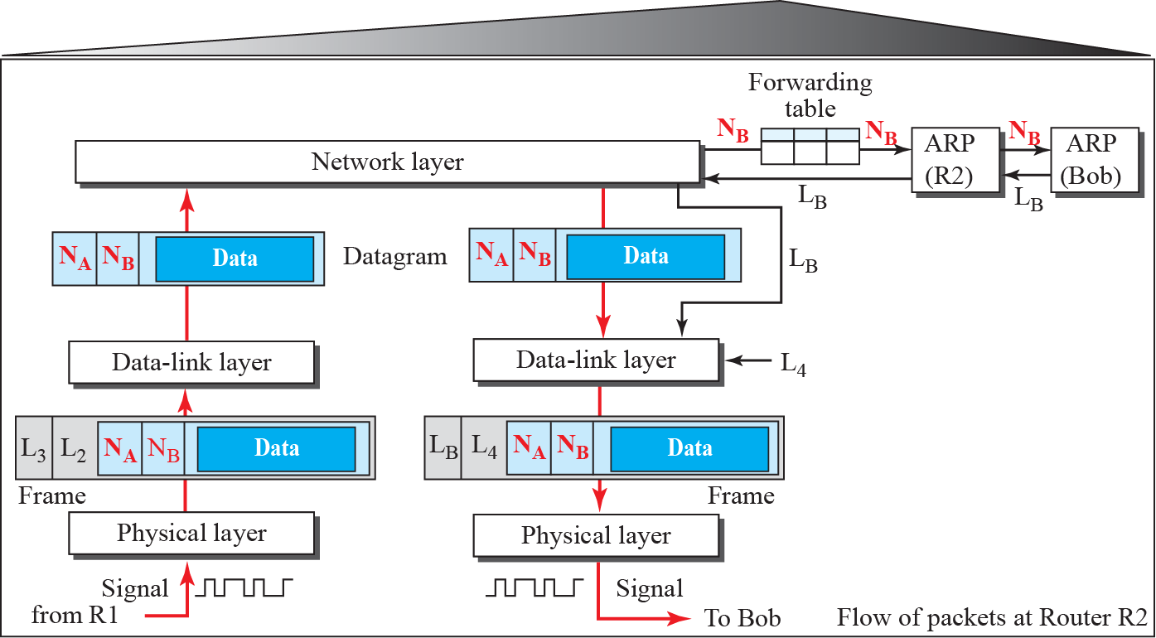
Flow of activities at router R2

Slide 29
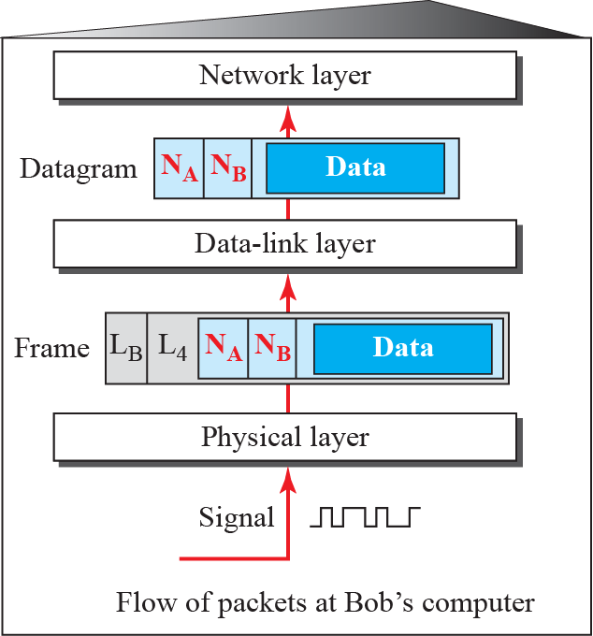
Activities at Bob’s site

